Slide 1
The Science of Information:
From Communication to DNA Sequencing
David Tse
U.C. Berkeley
CUHK
December 14, 2012
Research supported by NSF Center for Science of Information.
TexPoint fonts used in EMF: AAAAAAAAAAAAAAAA

Slide 2
Communication: the beginning
Prehistoric: smoke signals, drums.
1837: telegraph
1876: telephone
1897: radio
1927: television
Communication design tied to the specific source and specific physical medium.

Slide 3

Grand Unification
source
reconstructed source
Model all sources and channels statistically.
Shannon 48
Theorem:
A unified way of looking at all communication problems in terms of
information flow.

Slide 4
60 Years Later
All communication systems are designed based on the principles of information theory.
A benchmark for comparing different schemes and different channels.
Suggests totally new ways of communication (eg. MIMO, opportunistic communication).

Slide 5
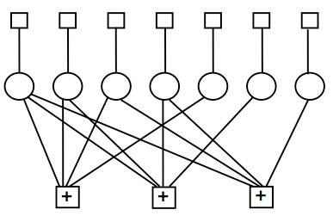
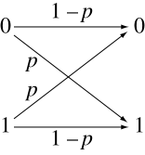
Secrets of Success
Information, then computation.
  It took 60 years, but we got there.
Simple models, then complex.
The discrete memoryless channel
………… is like the Holy Roman Empire.

Slide 6
Looking Forward
Can the success of this way of thinking be broadened to other fields?

Slide 7
Information Theory of DNA Sequencing
TexPoint fonts used in EMF: AAAAAAAAAAAAAAAA

Slide 8
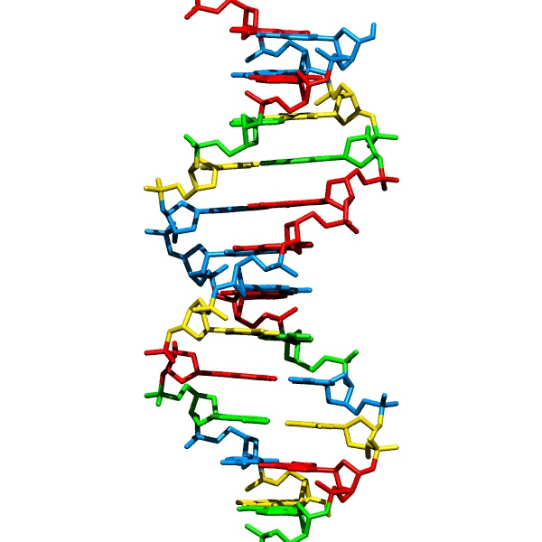
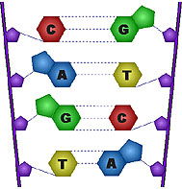
DNA sequencing
A basic workhorse of modern biology and medicine.
Problem: to obtain the sequence of nucleotides.
…ACGTGACTGAGGACCGTG
CGACTGAGACTGACTGGGT
CTAGCTAGACTACGTTTTA
TATATATATACGTCGTCGT
ACTGATGACTAGATTACAG
ACTGATTTAGATACCTGAC
TGATTTTAAAAAAATATT…
courtesy: Batzoglou

Slide 9
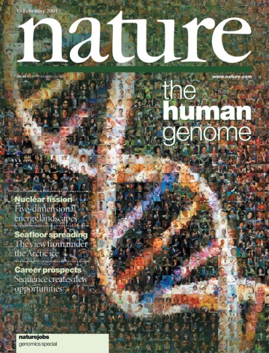
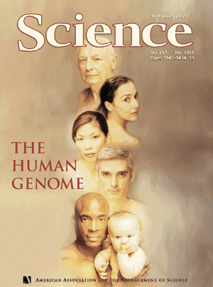
Impetus: Human Genome Project
1990: Start
2001: Draft
3 billion nucleotides
2003: Finished
3 billion $$$$
courtesy: Batzoglou

Slide 10
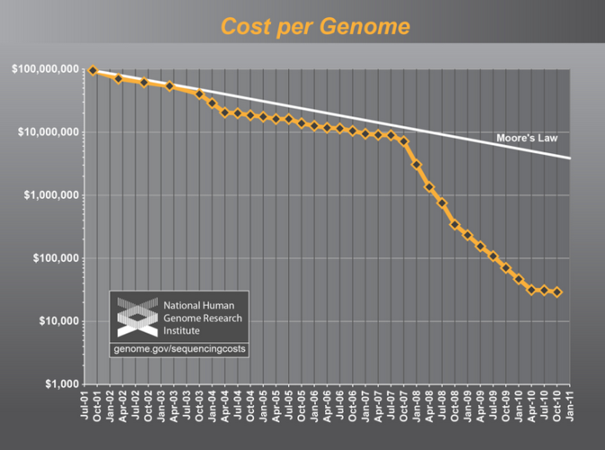
Sequencing gets cheaper and faster
Cost of one human genome
HGP: $ 3 billion
2004: $30,000,000
2008: $100,000
2010: $10,000
2011: $4,000
2012-13: $1,000
???: $300
courtesy: Batzoglou
Time to sequence one genome: years → days
Massive parallelization.

Slide 11
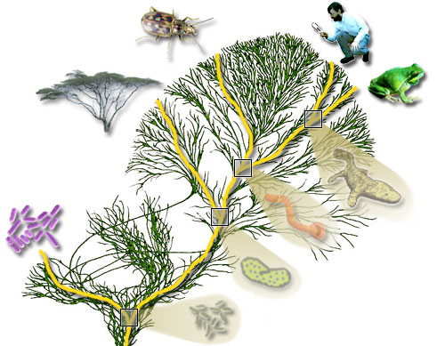
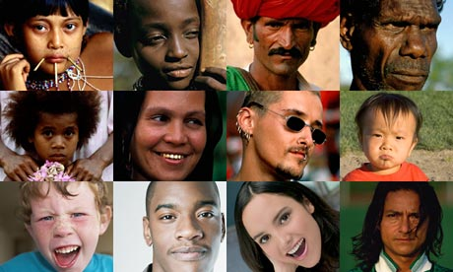
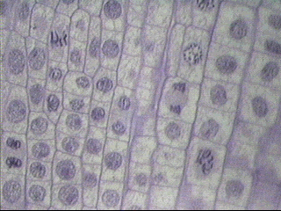
But many genomes to sequence
100 million species
(e.g. phylogeny)
7 billion individuals
(SNP, personal genomics)
10¹³ cells in a human
(e.g. somatic mutations
such as HIV, cancer)
courtesy: Batzoglou

Slide 12
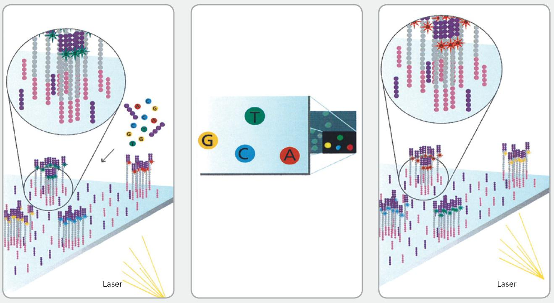
Whole Genome Shotgun Sequencing
genome length G ¼ 10⁹
Number of reads
N ¼ 10⁸
read length L ¼ 100 - 1000
Reads are assembled to reconstruct the original DNA sequence.

Slide 13
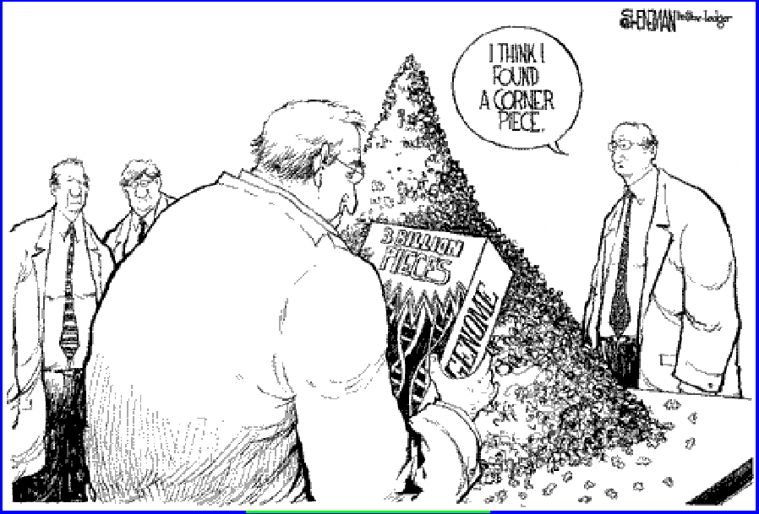
A Gigantic Jigsaw Puzzle

Slide 14
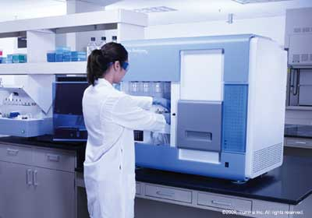
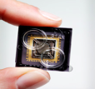
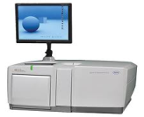
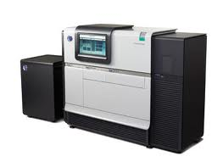
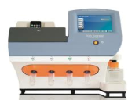
Many Sequencing Technologies
HGP era: single technology (Sanger)
Current: multiple “next generation” technologies (eg. Illumina, SoLiD, Pac Bio, Ion Torrent, etc.)
Each technology has different read length, noise statistics, etc
Eg.: Illumina: L = 50 to 200, error ~ 1 % substitution
Pac Bio: L = 2000 to 4000, error ~ 10-15% indels

Slide 15
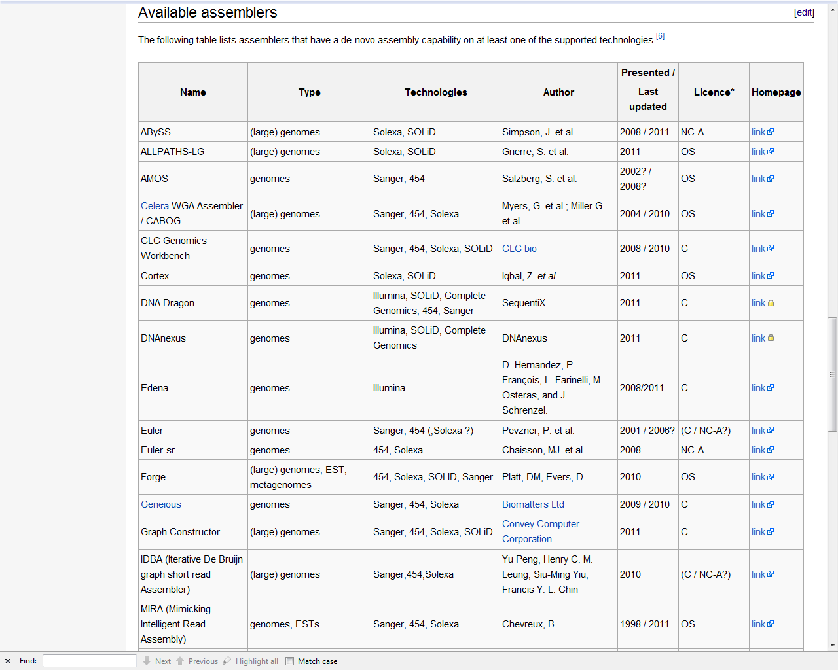
Many assembly algorithms
Source:
Wikipedia

Slide 16
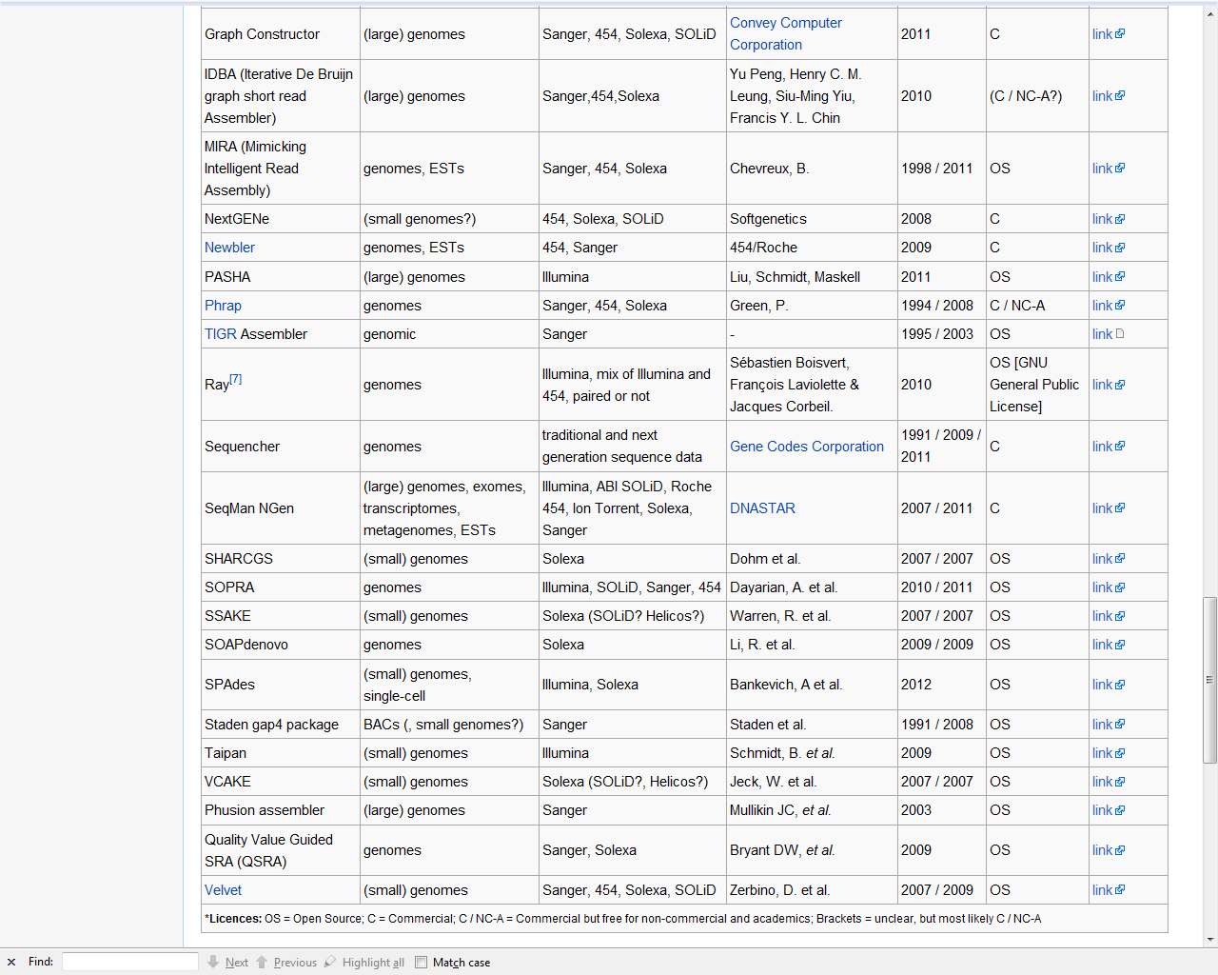
And many more…….
A grand total of 42!

Slide 17
Computational View
“Since it is well known that the assembly problem is NP-hard, …………”
algorithm design based largely on heuristics
no optimality or performance guarantees
But NP-hardness does not mean it is hopeless to be close to optimal.
Can we first define optimality without regard to computational complexity?

Slide 18
Information theoretic view
Given a statistical model, what is the read length L and number of reads N needed to reconstruct with probability 1-ε ?
Are there computationally efficient assembly algorithms that perform close to the fundamental limits?
Open questions!

Slide 19
A basic read model
Reads are uniformly sampled from the DNA sequence.
Read process is noiseless.
Impact of noise: later.

Slide 20
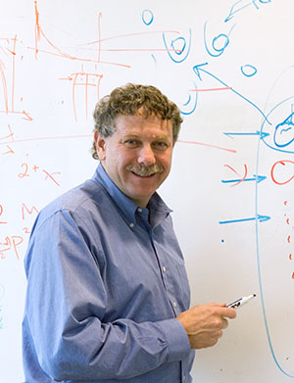
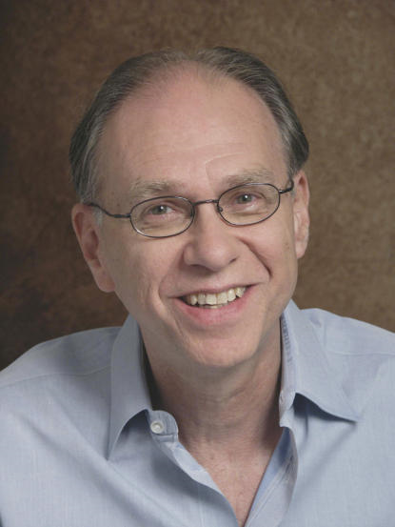
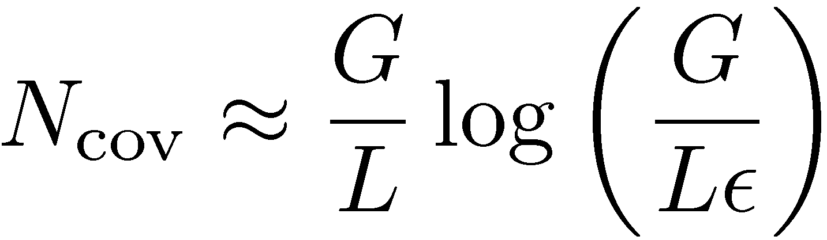
Coverage Analysis
Pioneered by Lander-Waterman
in 1988.
What is the number of reads needed to cover the entire DNA sequence with probability 1-²?
N_{cov} only provides a lower bound on the number of reads needed for reconstruction.
N_{cov} does not depend on the DNA statistics!

Slide 21

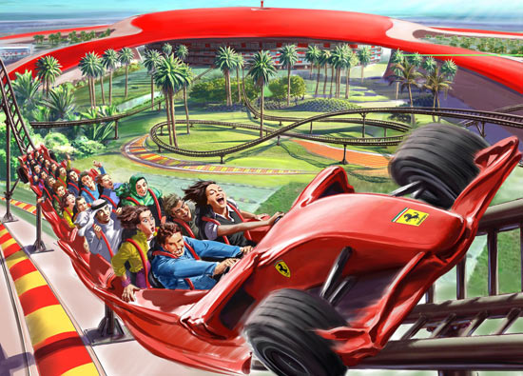
Repeat statistics do matter!
harder jigsaw puzzle
easier jigsaw puzzle
How exactly do the fundamental limits depend on repeat statistics?

Slide 22
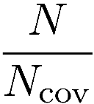
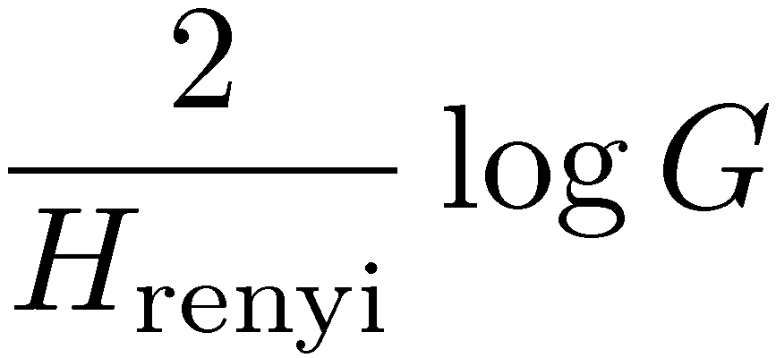
Simple model: I.I.D. DNA, G ! 1
normalized # of reads
(Motahari, Bresler & T. 12)
reconstructable
by greedy algorithm
coverage
1
many repeats
of length L
no repeats
of length L
no coverage
read length L
What about for finite real DNA?

Slide 23
I.I.D. DNA vs real DNA
(Bresler, Bresler & T. 12)
Example: human chromosome 22 (build GRCh37, G = 35M)
data
i.i.d. fit
Can we derive performance bounds directly in terms of
empirical repeat statistics?

Slide 24

Lower bound: Interleaved repeats
Necessary condition:
all interleaved repeats are bridged.
L
m
n
m
n
In particular: L > longest interleaved repeat length (Ukkonen)

Slide 25
Lower bound: Triple repeats
Necessary condition:
all triple repeats are bridged
L
In particular: L > longest triple repeat length (Ukkonen)

Slide 26
Chromosome 22 (Lower Bound)
triple repeat
interleaved repeat
what is achievable?
GRCh37 Chr 22 (G = 35M)
coverage
Notes:
Factor of 2 missing.

Slide 27
Greedy algorithm
  (TIGR Assembler, phrap, CAP3...)
Input: the set of N reads of length L
Set the initial set of contigs as the reads
Find two contigs with largest overlap and merge them into a new contig
Repeat step 2 until only one contig remains

Slide 28
Greedy algorithm: first error at overlap
repeat
contigs
bridging read already merged
A sufficient condition for reconstruction:
all repeats are bridged
L
Notes:
Add some animations to illustrate the two extreme cases

Slide 29
Chromosome 22
greedy
algorithm
lower bound
GRCh37 Chr 22 (G = 35M)
Notes:
Factor of 2 missing.

Slide 30
Chromosome 19
lower bound
greedy
algorithm
non-interleaved repeats
are resolvable!
longest interleaved repeats
at length 2248
longest repeat
at
GRCh37 Chr 19 (G = 55M)

Slide 31
de Bruijn graph
[Idury-Waterman 95]
[Pevzner et al 01]
CCCT
CCTA
GCCC
(K = 4)
ATAGCCCTAGCGAT
CTAG
AGCC
TAGC
ATAG
AGCG
GCGA
CGAT
1. Add a node for each K-mer in a read
2. Add edges for adjacent K-mers

Slide 32
Resolving non-interleaved repeats
non-interleaved repeat
Unique Eulerian path.

Slide 33
Resolving bridged interleaved repeats
bridging read
interleaved repeat
Bridging read resolves one repeat and the unique Eulerian
path resolves the other.

Slide 34
Resolving triple repeats
all copies bridged
neighborhood of triple repeat
triple repeat
all copies bridged
resolve repeat locally

Slide 35
Multibridging De-Brujin
Theorem:
Original sequence is reconstructable if:
(Bresler, Bresler & T. 12)
1. triple repeats are all-bridged
2. interleaved repeats are (single) bridged
3. coverage
Necessary conditions for ANY algorithm:
        triple repeats are (single) bridged
        interleaved repeats are (single) bridged.
        coverage.

Slide 36
Chromosome 19
triple repeat
lower bound
longest interleaved repeats
at length 2248
De-brujin algorithm
close to
optimal
longest repeat
at
GRCh37 Chr 19 (G = 55M)

Slide 37

GAGE Benchmark Datasets
http://gage.cbcb.umd.edu/
Rhodobacter sphaeroides
Staphylococcus aureus
Human Chromosome14
G = 4,603,060
G = 2,903,081
G =88,289,540
i.i.d. fit
data

Slide 38
Gap
Select a good example that shows the worst case gap and transition window size, and give the expressions.
Plot only interleaved lower bound, triple lower bound (dashed) and best upper bd.
Sulfolobus islandicus. G = 2,655,198
triple repeat
lower bound
De-Brujin
algorithm
interleaved repeat
lower bound

Slide 39
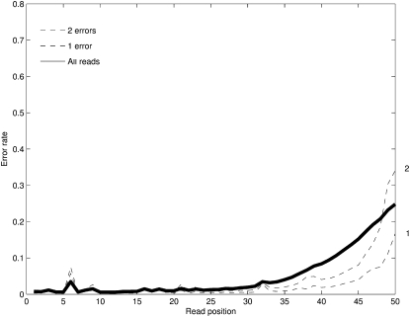
Read Noise
A
A
T
C
T
T
A
T
ACGTCCTATGCGTATGCGTAATGCCACATATTGCTATGCGTAATGCGT
Each symbol corrupted by a noisy channel.
Illumina noise profile

Slide 40
Erasures on i.i.d. uniform DNA
(Ma, Motahari, Ramchandran & T. 12)
Theorem:
If the erasure probability is less than 1/3, then noiseless performance can be achieved.
A separation architecture is optimal:
error
correction
assembly

Slide 41
Why?
noise averaging
Coverage means most positions are covered by many reads.
Aligning noisy reads locally is easier than assembling noiseless reads globally for p_{erasure} < 1/3.

Slide 42
Conclusions
A systematic approach to assembly design based on information.
More powerful than just computational complexity considerations.
Simple models are useful for initial insights but a data-driven approach yields a more complete picture.

Slide 43
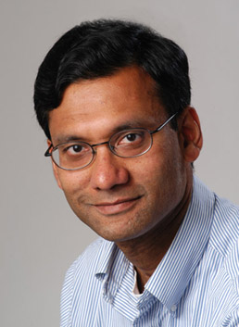
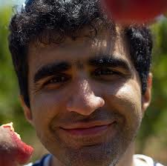
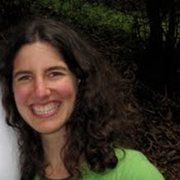
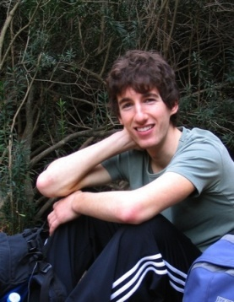

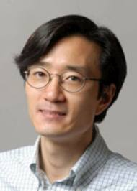
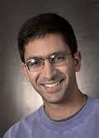
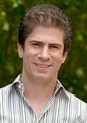
Collaborators
Abolfazl
Motahari
Ma’ayan Bresler
Kannan
Ramchandran
Guy Bresler
Nan Ma
Acknowledgments
Yun Song Lior Pachter Serafim Batzoglou
TexPoint fonts used in EMF: AAAAAAAAAAAAAAAA

